Slide 1
Welcome to Grade 3 / 4 Information Session 2022

Slide 2
Curriculum

Slide 3
English
Writing: Writing is done everyday and uses the 6 + 1 Traits model to develop students writing. The model is based on the premise that good writing consists of a good idea, strong vocabulary, fluent sentences, a writer’s voice and includes conventions ie punctuation.
This term students are learning what the traits of good writing are, where to find ideas and how to write descriptively and construct a narrative.
Handwriting: Explicit lessons are done on letter formation, size and spacing. Students work towards developing fluency and neatness.
Reading: Reading is done everyday and consists of independent reading, explicit teaching of comprehension strategies and small group guided sessions.
This term students are learning how to choose ‘Just Right’ books, visualize as they read and make connections to help with comprehension.
Spelling: Consists of the SMART spelling approach and personal spelling words.

Slide 4
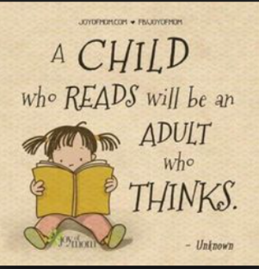
What you can do at home.
Have your child read each night to you, an adult, sibling or independently.
Help them choose ‘Just Right’ books.
Read to them sometimes and make it fun.
Talk about what they are reading, ask questions.
DIARIES - Encourage your child to record what they read in their diaries and send these in every day.
Write letters, list, read recipes etc.
Practice spelling and handwriting
Talk to them and take an interest in their schoolwork.

Slide 5
Maths
Number –
Students in Grade 3/4 will learn about the place value of digits in numbers and will read, write, represent and order numbers to at least 1 000, extending to 10 000 and beyond. They will identify numbers as being odd or even and round numbers up to the nearest 10 / 100. They will locate numbers on number charts and number lines and predict what 1 more, 1 less, 10 more and less and 100 more and less will be. They will develop number sense through games and hands on activities.
Measurement and Geometry
Students will measure, order and compare objects using familiar metric units of length, mass and capacity. They use scaled instruments to measure and compare lengths, masses, capacities and temperatures.
Statistics and Probability
Students collect data, organise into categories and create displays using lists, tables, picture graphs and simple column graphs with and without computers.

Slide 6
Maths
Things you can do at home.
Play board games
Encourage your child to use Mathletics or Prodigy if they get computer time.
Talk about money when shopping.
Tell the time

Slide 7
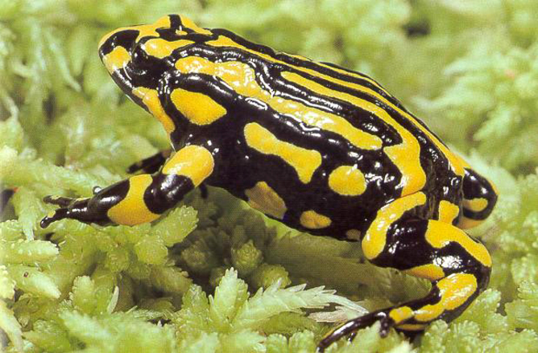
Inquiry
Investigation v Inquiry
Each term we focus on a new Inquiry, such as Ourselves, History, Endangered Species, the environment or our country.
Voice and choice
Homework should be fun and not contain new work.
What you can do at home.
Discuss the inquiry topic with your child.
Engage with your child’s homework and help them to establish positive
work routines.
Watch nature shows and videos
Read information text together.

Slide 8
Transition
Transitioning from the junior unit to the middle unit can be a big step for students.
Physically moving from one building to the other.
Taking responsibility for their own supplies and books.
Classrooms are more structured, no investigation time.
Introduction to computers, which are used more for assessment, research and presenting work.
Increased independence and gradual release of responsibility for their own learning.
New friendships need to form.

Slide 9
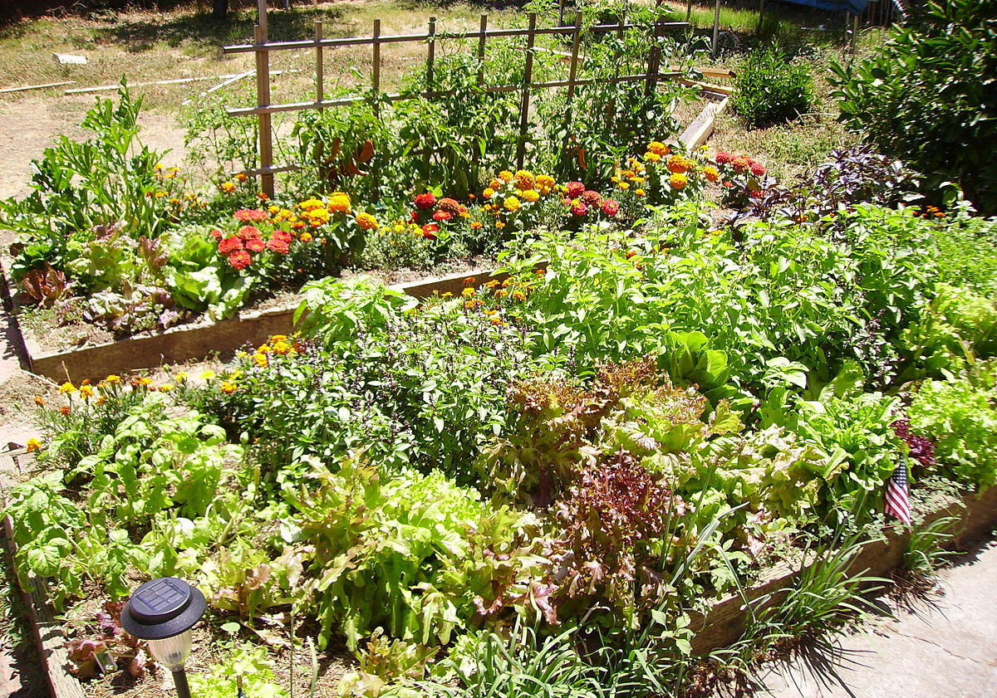
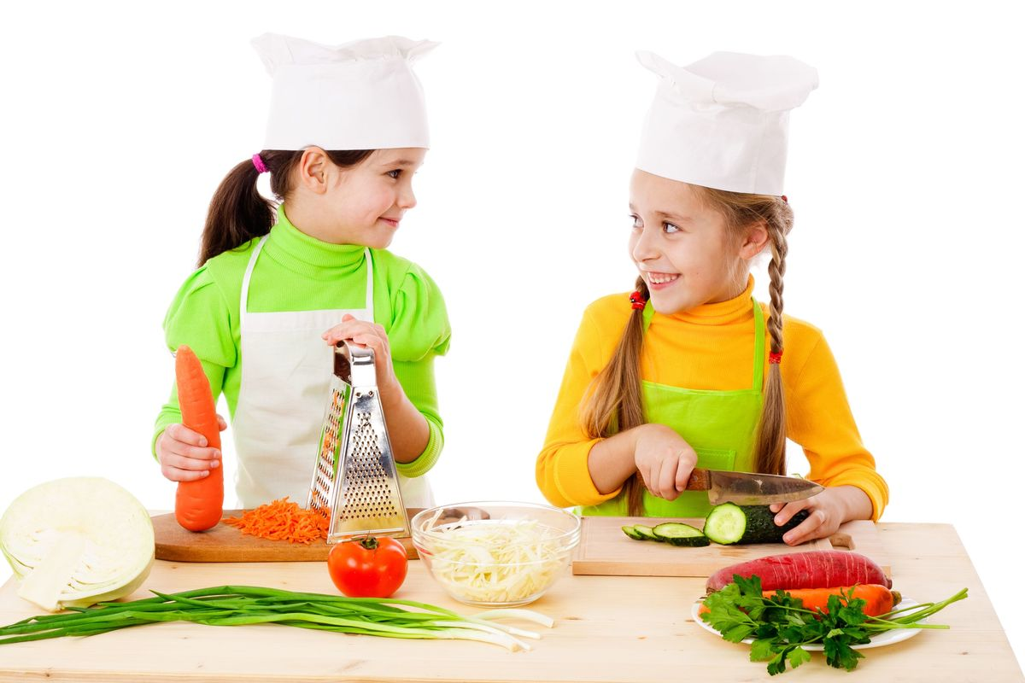
Specialists
This year the students have an hour of:
Art with Sheridan Leversha
PE with Laura Hicks
Music with Bridget Finch
Gardening with Sara Hill
Mandarin with Yu Ling Wu

Slide 10
The focus in our primary art room is to develop a love of art, of creative expression and the enjoyment that comes from this. Students work on problem solving, cooperative learning, giving constructive feedback to each other and the development of ideas. These are all transferable skills that apply to all areas of the curriculum and we often link what we do in the art room to what I know students are learning in their classrooms, most often to writing as the conception of an idea and working through it to a final product is a similar process to what we do in the art room.
Art
Our art program is formally known as Teaching for Artistic Behaviour (more information about this philosophy can be found http://teachingforartisticbehavior.org/index.html
It is a choice based program that allows students to be artists and create their own artwork based on their interests. TAB focuses on three main concepts:
What do artists do?
The child is the artist.
The art room is their studio.
We also look at the eight Studio Habits of Mind:
Develop Craft (Technique & Studio Practice) Engage & Persist (Finding Passion & Sticking with It) Envision (Imagining & Planning) Express (Finding & Showing Meaning) | Observe (Looking Closely) Reflect (Question & Explain and Evaluate) Stretch & Explore (Play, Use Mistakes & Discover) Understand Art Worlds (Domain & Communities)

Slide 11
This year we are focusing on ideas – where they come from and what artists do with them when they have one. We will sometimes use picture story books as a jumping off point, and sometimes I will share an idea and ‘think out loud’ to show my process of developing it further, and sometimes our students will share their ideas and their processes to inspire each other.
Art
T – tell the artist something you like about their work
A – ask the artist a question about their work or process
G – give the artist a suggestion for something they could add to their work
This is something you can do at home as well, although hopefully we won’t have any more home learning this year!
Sometimes, particularly when learning a new skill or how to use a new material, students might not actually produce what we adults would recognise as a finished work of art. Not every artwork will be polished and perfectly presented. I actively encourage students to use scrap paper to experiment with a variety of materials, such as oil pastels or paints, to see what they can do with that particular thing. Students in grades 3-6 also tend to work on projects over many weeks, and often in partnerships (usually with 3D sculpture projects), so don’t be alarmed if art work does not make it home to be put on the fridge.
Our focus is on developing students as artists and creative problem solvers, rather than having students copy a ‘project of the week’. One of the greatest joys is seeing all the different paintings and drawings that students produce, rather than a class set of the exact same thing.

Slide 12
Music in Grades 3-4
The aim of Music at BVSPS is:
For each child to experience the role of composer, listener and performer
To provide music activities which are engaging, creative and challenging and promote self-confidence
To complement the Play is the Way (Wilson) social competencies program
This is achieved by:
Playing musical games and moving creatively to songs from a wide range of genres
Playing a range of tuned and untuned instruments focusing on musical elements like rhythm, beat, tempo and pitch
Learning to care for and use the voice to sing familiar and unfamiliar songs
Providing a choral program for grades 3-6 which gives students the opportunity to hone their singing skills and gain confidence through performance.
I am hoping choir can recommence this year and we will be able to visit Estia Aged Care Facility once again for fortnightly performances in Terms 2 and 4. All going well, your child will be given the opportunity to ‘sign up’ for choir in Term 2.
Learning a tuned instrument – Grades 3-4 learn to play ukulele throughout the year. We will begin learning ukulele within the next few weeks!
Please feel free to chat with me if you have any questions or would like more information.
Miss Finch

Slide 13
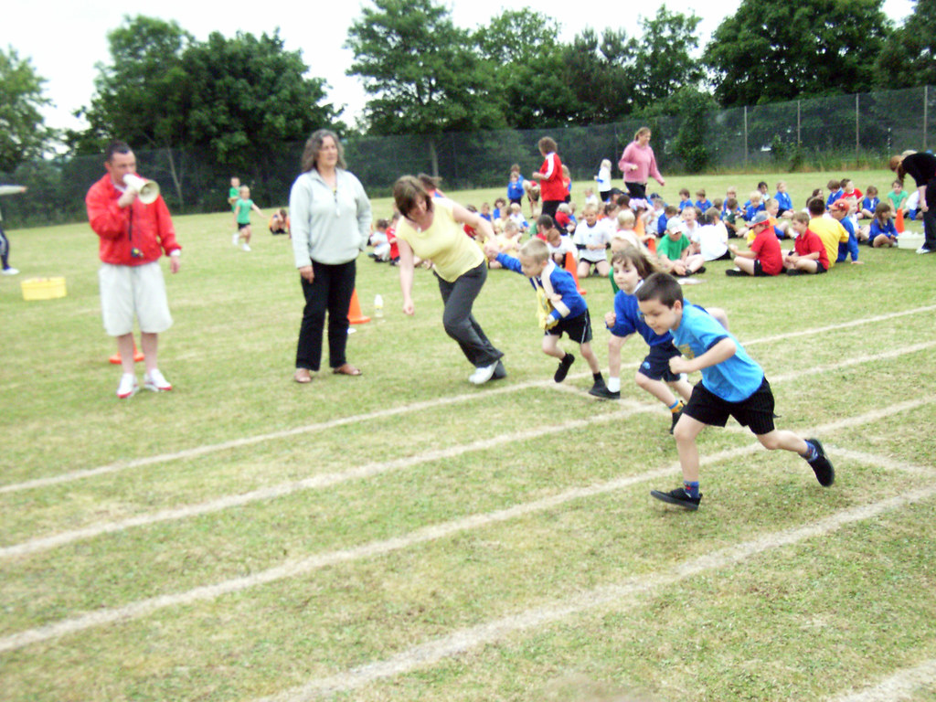
PE with Mrs Hicks
Class Expectations
Participation
Sportsmanship
Teamwork
Have FUN
Suitable footwear
Hats
Drink bottle

Slide 14
Useful Information
Canteen Orders are Wednesday
Asthma: Children require their own spacer if using their own inhaler at school.
Due to children with allergies please try to avoid foods containing nuts and try to limit wrappers to help our environment.
Please check your child’s hair regularly to help control lice infestation.
Hats are required this term and again in term 4.
Students are encouraged to bring a water bottle each day.
Breakfast club is on a Wednesday morning from 8.00 for students only at the moment. Families will be informed when this will change.
Reading club is in the library from 8:00 on Monday and Tuesday. And walk to school is on Thursday, meeting at Garden Gully at 8:00 too.

Slide 15
More Useful Information
Newsletters will be emailed on a Wednesday, please read with your child.
Notes will come home occasionally so check your child’s bag.
The school’s Web Page and Facebook both contain extra information and reminders.
For absences- please let the school know by either ringing/ texting on 54436411, or by logging in on Sentral or sending along a note.
Late arrivals need to sign in at the office.
When sending in money, please put it in an envelope with your child’s name.
A copy of both classes timetable have been attached for you to have a look at.

Slide 16
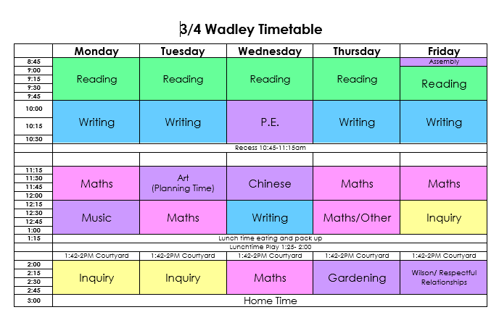
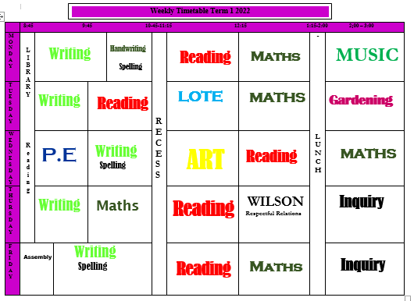
Timetables for both room are on display in the classroom and are in the term newsletters so that the students know which days they have specialist subjects

Slide 17
Social Competencies
Our school’s approach to developing social competency is based on Wilson McCaskills ‘Play is the Way’
Wilson’s approach aims at teaching children to be –
independent,
self-managing,
self motivated learners, who are able to get along and show empathy
We teach these skills through play, discussions and by using a consistent language.

Slide 18
Beliefs behind The Game Factory.
A child’s well-being and success in later life rests on the five pillars of emotional intelligence.
- An awareness of others (Empathy)
- Self Control,
- Self Awareness,
- Self Motivation and
- Managing Relations.
We cannot leave the learning of emotional intelligence and social competence to chance.
We need to make social competence an emotional intelligence an integral part of the curriculum.
It take.s time to develop these skills. Children learn best by doing and through small lessons over many years
The program does this through
1. Games- which help students learn to work together and learn the pillars of success and
2. The consistent use of questioning and language.
‘Children aren’t made of China’ by Wilson McCaskill – Can be borrowed if interested.

Slide 19
The strength of Wilson’s approach is the power of his words. Used consistently, it strongly encourages students to be self controlled and thoughtful.
Is that necessary or unnecessary?
Is that the right thing or wrong thing to do?
Are your feelings in charge or is your thinking?
Are you having a strong moment or a weak one?
Am I trying to hurt you or help you?
Are you ready to be your own boss or do you need me to be?
‘Children aren’t made of China’ by Wilson McCaskill – Can be borrowed if interested.
‘Ask questions more than make statements. Questions create interaction and thoughts. Commands seek compliance with no thought.’
- Wilson McCaskill

Slide 20
Questions
We look forward to working together with you and your child/children throughout 2022.
Dianne, Danielle and Sheridan

